Slide 1

AIML Group Lab Team 9
An Image Processing Approach to Detect Lanes, Potholes and Recognize Road Signs in Indian Roads

Slide 2
Agenda
Problem Statement
Introduction to Team
Response to the Questionnaire (Refer Abstract)
Business Applications, Post course
Q & A

Slide 3
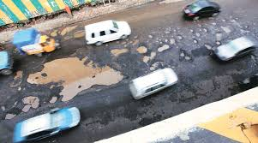
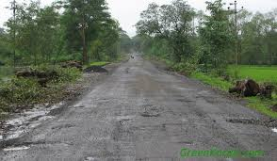
Problem Statement
Majority of the Indian roads are not ideal for autonomous vehicles due to:
faded or missing lanes
unexpected potholes
Irregular speed breakers
improper, invisible or missing road signs
With the fact that there are is not enough data/images available, this poses a daunting challenge to design an autonomous vehicle that is safe and comfortable

Slide 4
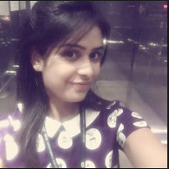
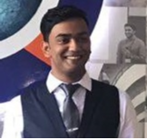

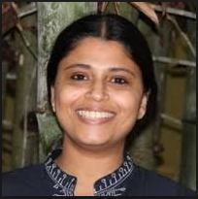
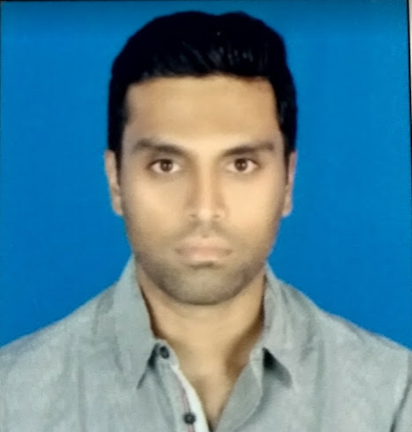
Team
Aayushi Gautam - TCS
Vishrudh Reddy - CISCO
Anushree TP - IBM
Fathima Sait- SCB
Imran Noor - Accenture

Slide 5
Data
Images of potholes, speed bumps etc
Stream of video frames to detect road signs and lanes
Images and video frames in different weather conditions, for clear and dusty roads in different angles.
Links to data set:
http://benchmark.ini.rub.de/?section=gtsrb&subsection=dataset
https://www.researchgate.net/publication/282807920_Dataset_of_images_used_for_pothole_detection
https://www.researchgate.net/project/Dataset-for-Lane-Detection
Infrastructure required for additional data collection:
Low-cost frame grabber and a i-core based computer system for on-line real-time operations.

Slide 6
Pre-processing
ROI Segmentation with Image Thresholding
Image Smoothing to suppress image noise which leads blur to sharp edges
Thinning and Edge Detection
Identifying the Region and Clustering

Slide 7
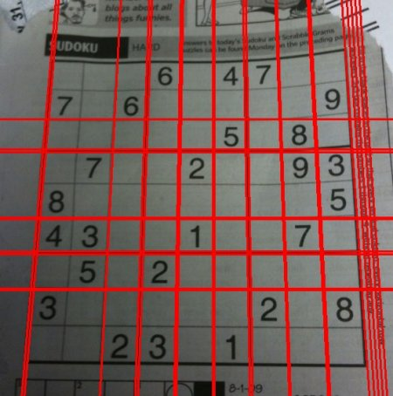
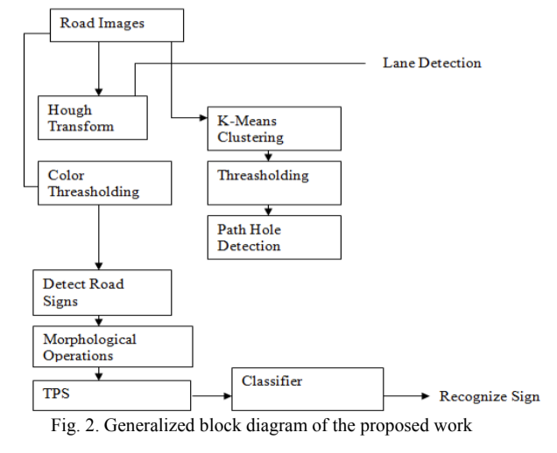
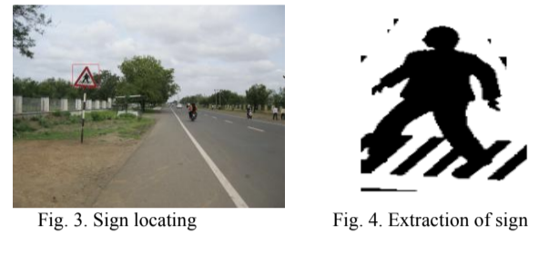
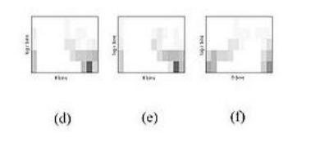
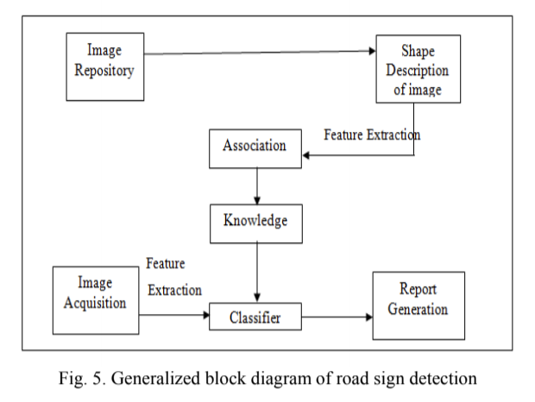
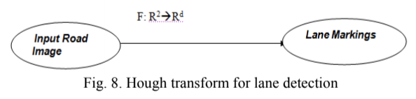
Algorithms
Lane Detection :
Houghs Transform
Genetic Algorithm
Pothole & Speed Breaker Detection :
K-means Clustering
Thresholding
Detection of Road Signs:
TPS
Classifier (KNN)
Validation:
F1 score is a valid metric for measurement.
Recall is essential for Pothole & Speed Breaker Detection
while for Road Sign, Accuracy is a valid measure

Slide 8
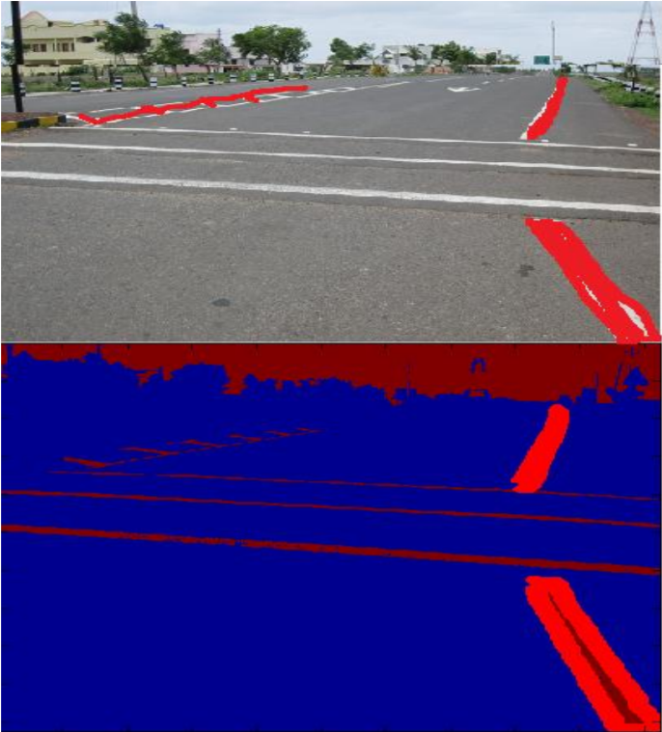
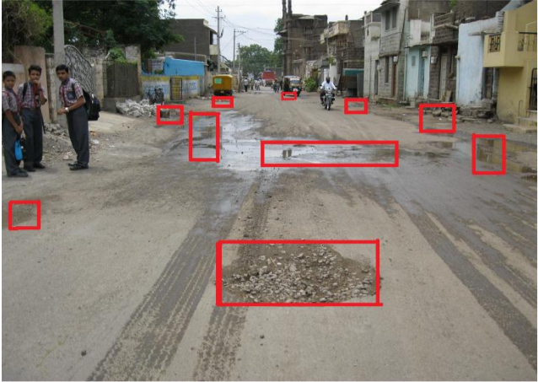
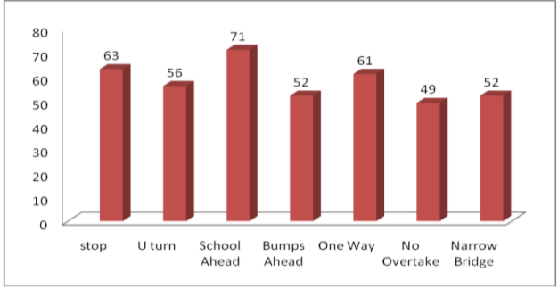
Expected End Results

Slide 9
Post Course
Develop this model and test with larger datasets
Work with startups/agencies to productionize the solution:
http://fluxauto.xyz/ → Bangalore-based startup working on sef driving technology for new and existing commercial vehicles.
ATImotors: → Bangalore-based startup designing autonomous electric cargo vehicles, with a major focus on customers outside India.

Slide 10
Q & A

Slide 11
Thank you!

